Slide 1


HOME LOAN PREDICTION ANALYSIS
building a model that predicts if someone should be given a home loan or not.

Slide 2

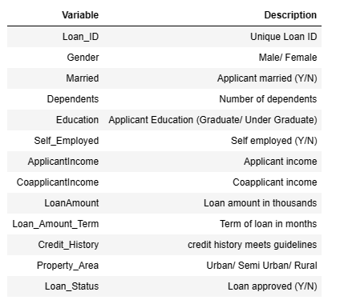

Data description
The objective is to build an automated model that predicts whether a person should be given a loan or not based on certain features.
The company wants to automate the loan eligibility process (real-time) based on customer detail provided while filling out the online application form

Slide 3


Exploratory Data Analysis

Slide 4

THE EDA STEP
The process involves;
Importing libraries & reading in the data,
Getting an overview & shape of the data,
Getting the data types & the summary statistics,
Obtaining the nulls, duplicated & unique values,
Developing the Correlation matrix.
Then I did some data visualization to further understand feature characteristics

Slide 5
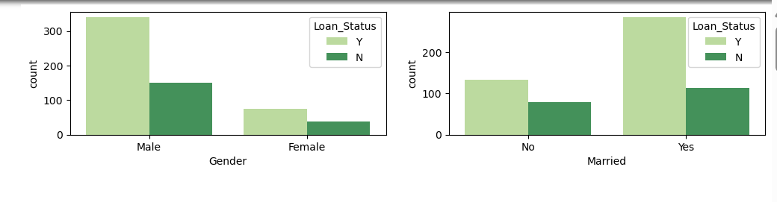
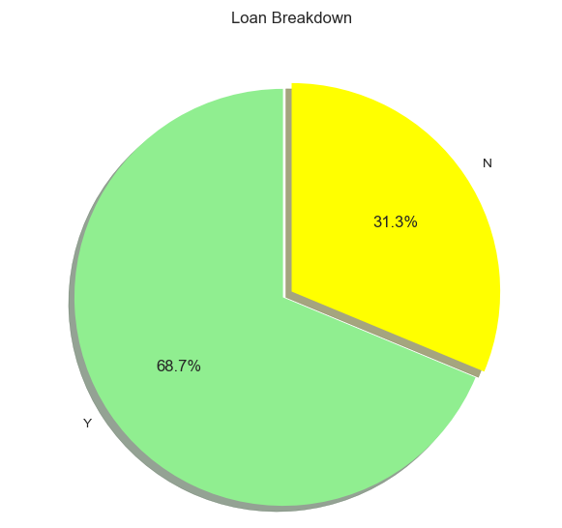
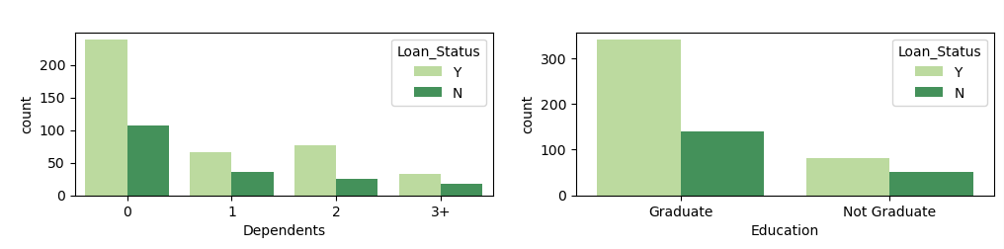
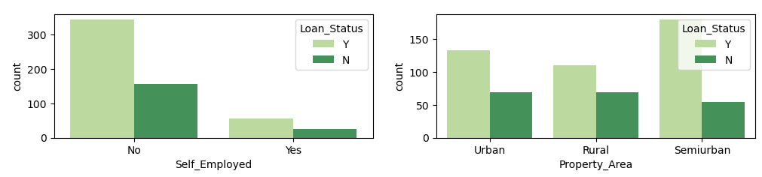
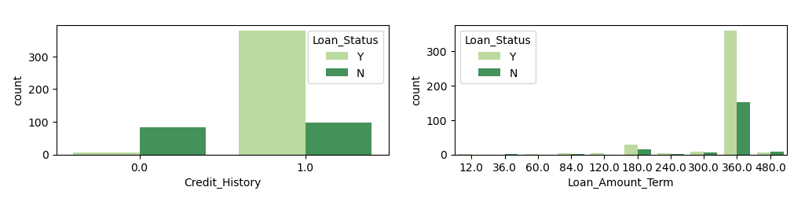
Number of loan approvals and Relationships with Categorical Variables

Slide 6
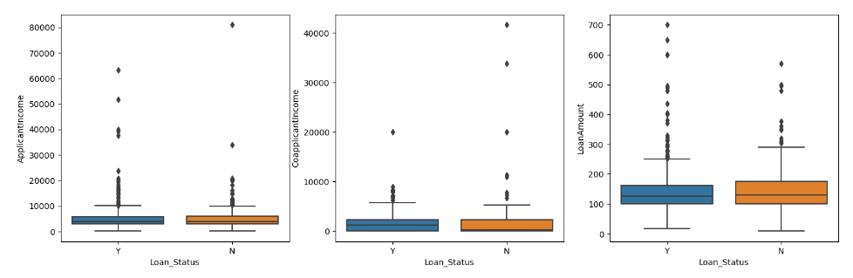
Relationship with Quantitative Variables
Plots above convey following things about the dataset:
Loan Approval Status: About 2/3rd of applicants have been granted loan.
Sex: There are more Men than Women (approx. 3x)
Martial Status: 2/3rd of the population in the dataset is Marred; Married applicants are more likely to be granted loans.
Dependents: Majority of the population have zero dependents and are also likely to accepted for loan.
Education: About 5/6th of the population is Graduate, they have higher proportion of loan approval
Employment: 5/6th of population is not self employed.
Property Area: More applicants from Semi-urban and also likely to be granted loans.
Applicant with credit history are far more likely to be accepted.
Loan Amount Term: Majority of the loans taken are for 360 Months (30 years).
For Numerical Columns, there is no significant relation to Loan approval status.

Slide 7

DATA PREPROCESSING STEP
In this step;
I encoded the categorical features using get_dummies(),
Imputed the missing values with the mean,
Split features and target variables,
Then I split the data into training(80%) and testing data(20%),
Scaling and transforming the data
Conducting SMOTE analysis to deal with class imbalance.

Slide 8

MODEL BUILDING
I built four models;
Logistic Regression, KNN, Decision Tree, and Random Tree. I used GridSearchCv for hyperparametertuning and cross-validation.
Then chose the best model based on F1 scores, accuracy, precision, recall, and ROC curves.

Slide 9
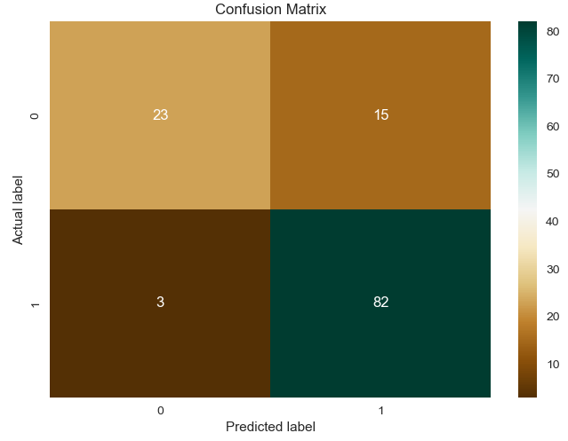
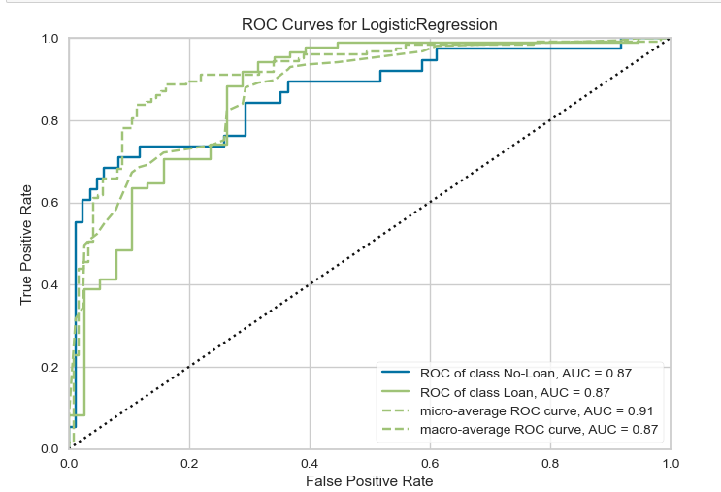
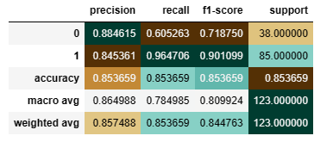
LOGISTIC REGRESSION

Slide 10
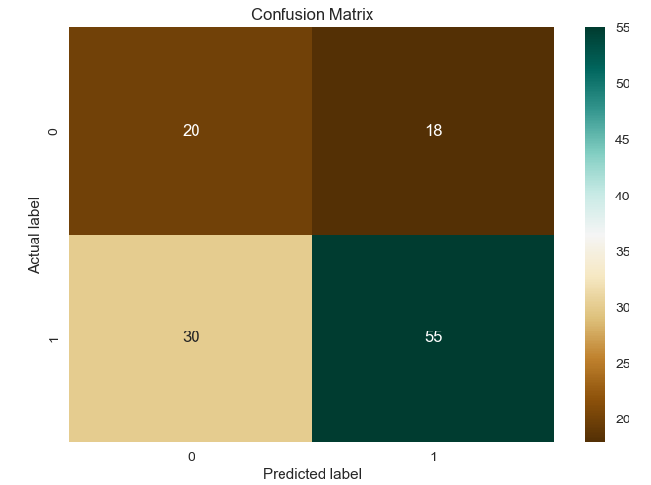
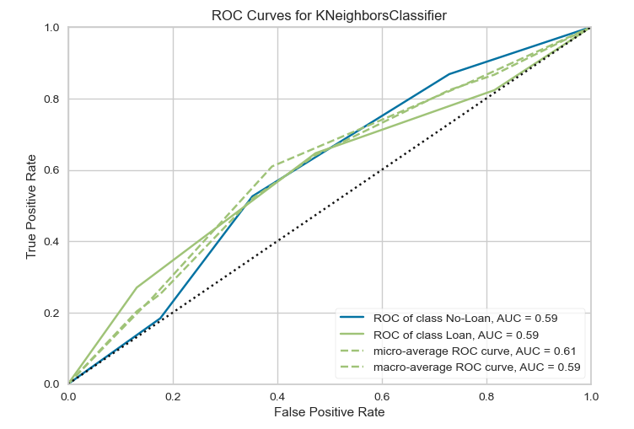
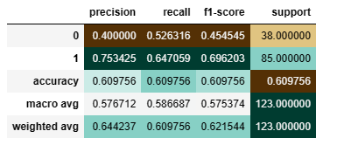
KNN(K Nearest Neighbor)

Slide 11
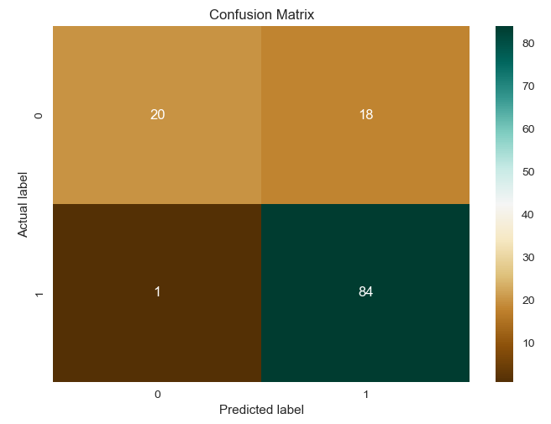
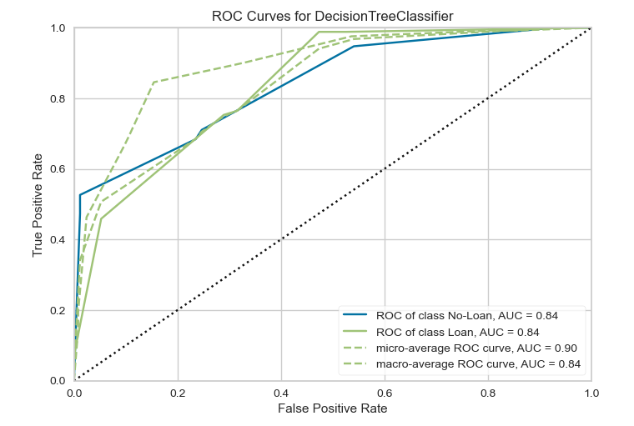
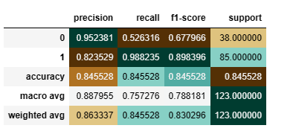
DECISION TREE CLASSIFIER

Slide 12
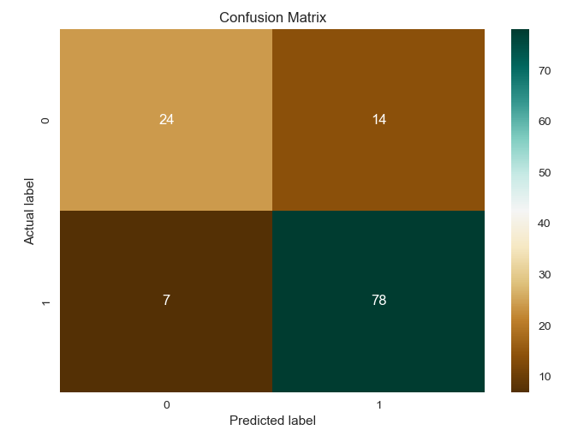
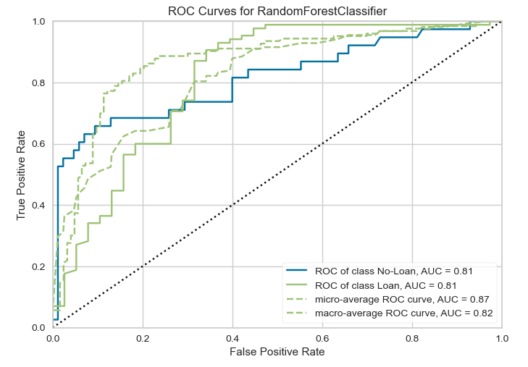
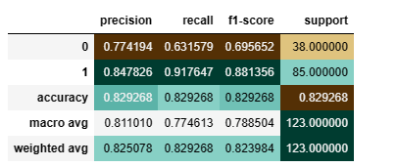
RANDOM FOREST

Slide 13
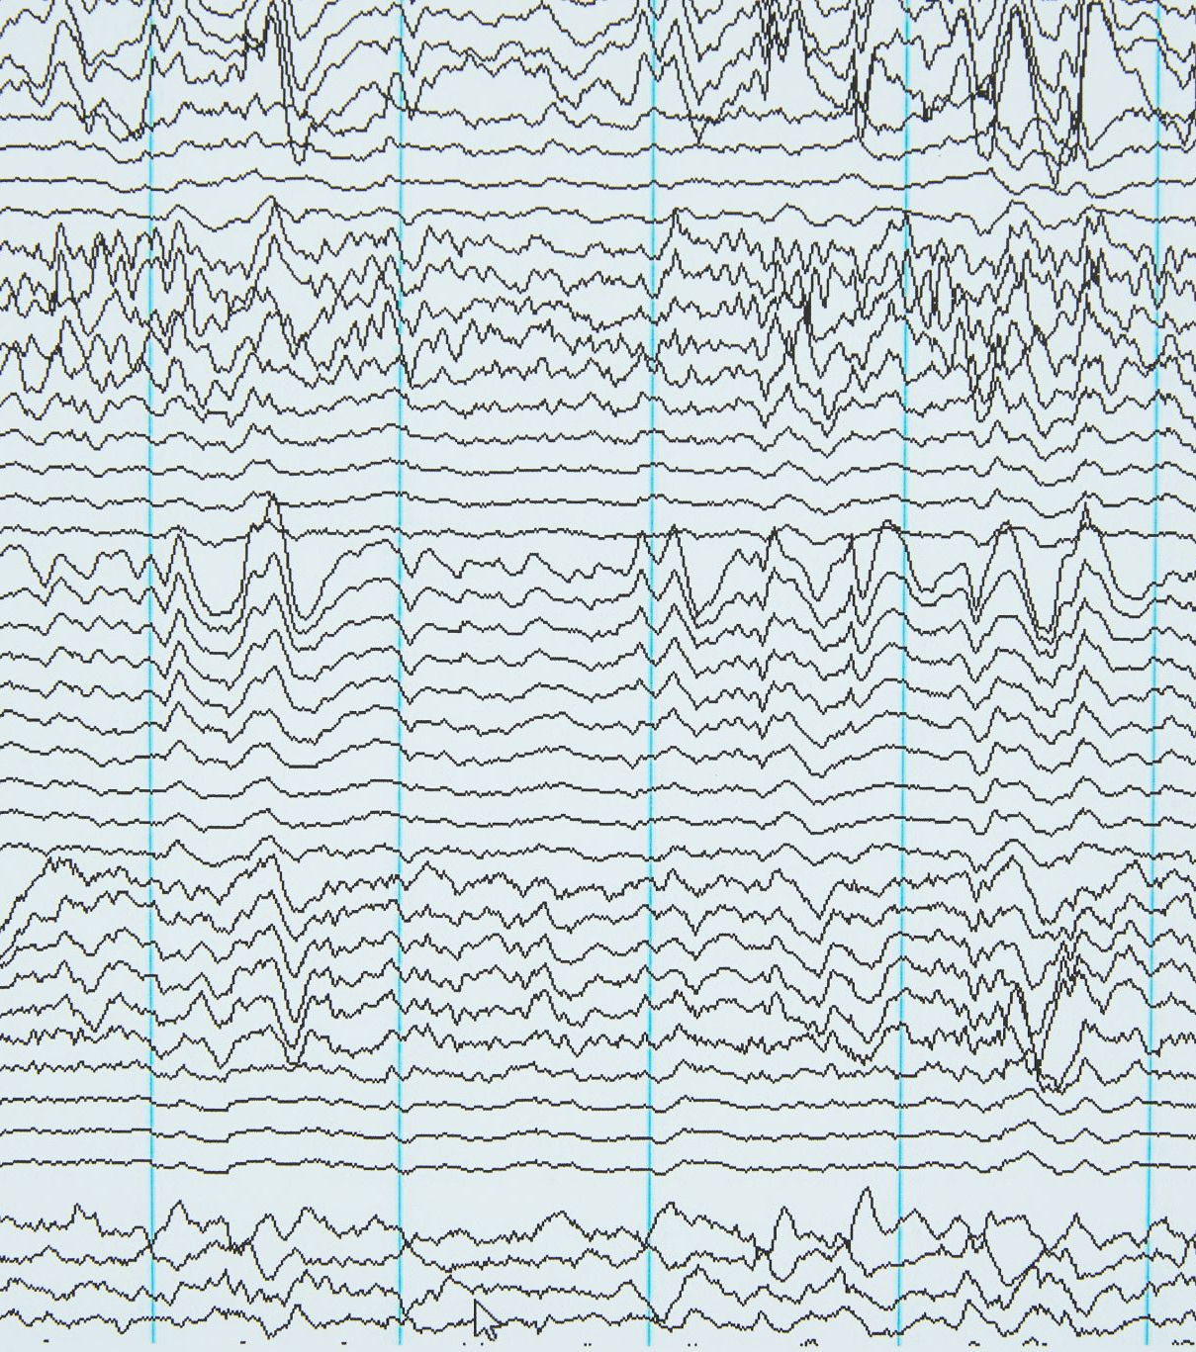
CONCLUSION
The Logistic Regression Model is the best model with an F1 score of 0.90 and an accuracy of 0.85
Also, The closer the ROC curve is to the upper left corner of the graph, the higher the accuracy of the test because in the upper left corner, the sensitivity = 1 and the false positive rate = 0 (specificity = 1). This is the case with the logistic regression ROC curve.
We can improve the algorithm by using ensemble methods like combining the model with other techniques such as bagging/boosting. Also, stratified K-fold cross validation may help improve the model.

